Slide 1
Queue and Service Flow Management System
A digital queue and multi-stage government service flow system for government offices in Nepal
Presented By:
Siddhartha Shakya
1

Slide 2




Problem statement
Citizens often face fragmented information about service stages, required documents, counters and expected waiting time.
Traditional and manual queue handling becomes difficult for multi-stage services and multiple counters, increasing staff workload and reducing queue visibility.
Limited real-time updates and notifications can cause missed turns, unnecessary waiting and poor service transparency.
2

Slide 3
Objectives
To digitize the complete government service journey from service information and token generation to stage completion.
To automate stage-specific queuing, token calling, counter check-in, waiting-time estimation and citizen notifications.
3

Slide 4
Development methodology
Incremental Waterfall Model
The system is developed feature by feature in defined increments.
Each increment follows requirements, database/API design, backend development, testing, frontend integration and complete feature testing.
Completed increments provide a stable base for the next increment.
Major increments include project foundation, service information, digital token and queue, multi-stage service flow, and waiting-time estimation.
4

Slide 5
Functional requirements
User registration and authentication for citizens and staff.
Browse, search and view government services, offices, stages and required documents.
Generate, view, cancel and track digital queue tokens.
Manage stage-specific queues: waiting, called, serving, skipped and completed.
Estimated waiting-time calculation based on queue and counter conditions.
Notifications for approaching turns, turn calls and stage progress.
Staff dashboard with office-restricted queues, search, filtering, sorting and token actions.
5

Slide 6
Non-functional requirements
Usability: interfaces should be simple and understandable for citizens and staff.
Responsiveness: the system should remain usable on desktop and mobile devices.
Performance: queue updates and token information should refresh within a short interval.
Security: authenticated actions and staff access should be restricted to authorized users and offices.
Reliability: queue state and token transitions should remain consistent across service stages.
Scalability: staff queues should remain manageable as the number of tokens increases.
Maintainability: service stages, counters, documents and office assignments should be data-driven.
6

Slide 7
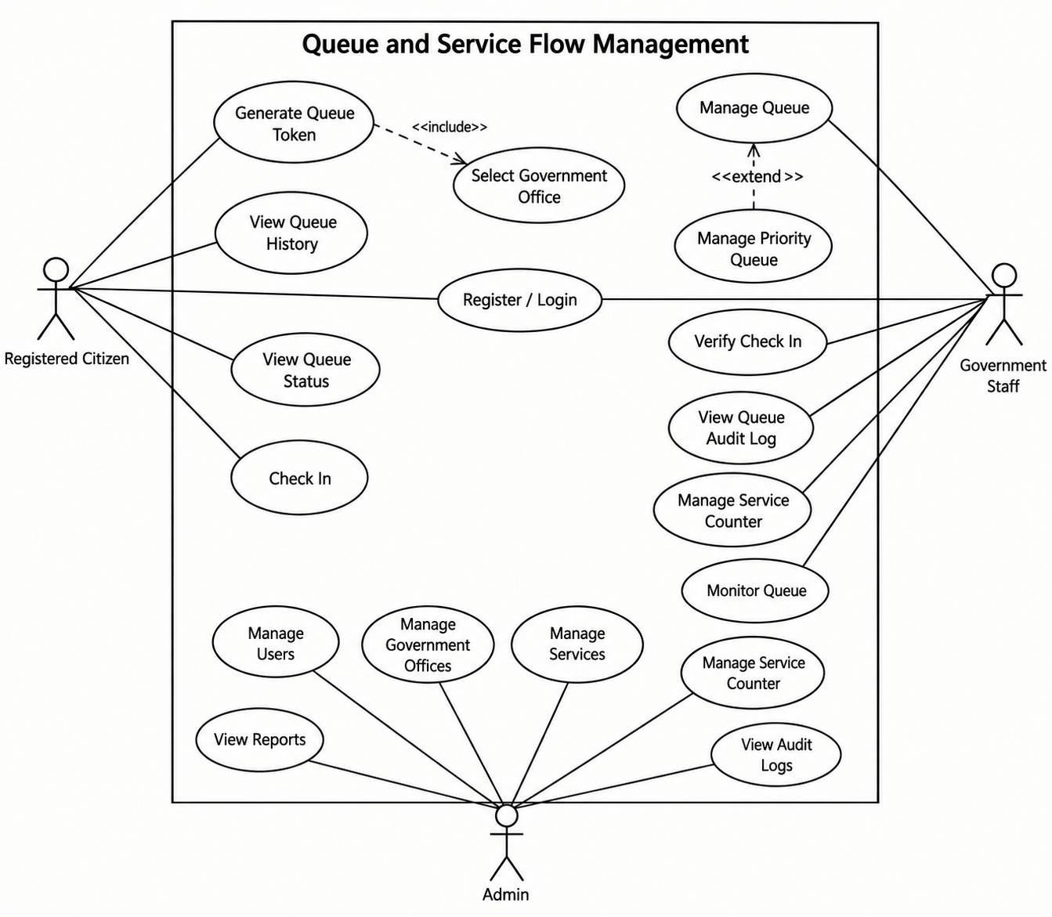
Use case diagram
7

Slide 8
Technology used
Frontend: React, Vite, Tailwind CSS
Backend: Node.js with Express.
Database: PostgreSQL with Prisma ORM.
Authentication and security: JWT, bcrypt, Helmet and CORS.
Internationalization: i18next and react-i18next for English and Nepali support.
Client utilities: Axios, QR Code generation and Progressive Web App support.
Development environment: JavaScript / JSX with npm-based tooling.
8

Slide 9
Implementation modules
Authentication and user management
Government office and service management
Service roadmap and required-document guidance
Digital token generation and queue-position management
Stage-specific queue and multi-counter management
Automatic token calling, counter check-in and service completion
Waiting-time estimation and queue monitoring
Citizen notifications and notification history
Staff dashboard and office-restricted queue operations
Public live queue monitor and QR support
9

Slide 10
Conclusion
The proposed system centralizes government service guidance, digital queuing and multi-stage service flow.
Citizens can understand service stages, reserve queue positions, receive notifications and monitor progress remotely.
Staff can manage queues according to office responsibilities and current counter capacity.
Stage-specific queues and dynamic waiting-time estimation improve transparency and reduce unnecessary waiting.
10

Slide 11
Thank You
Questions and Discussion
11

